Slide 1
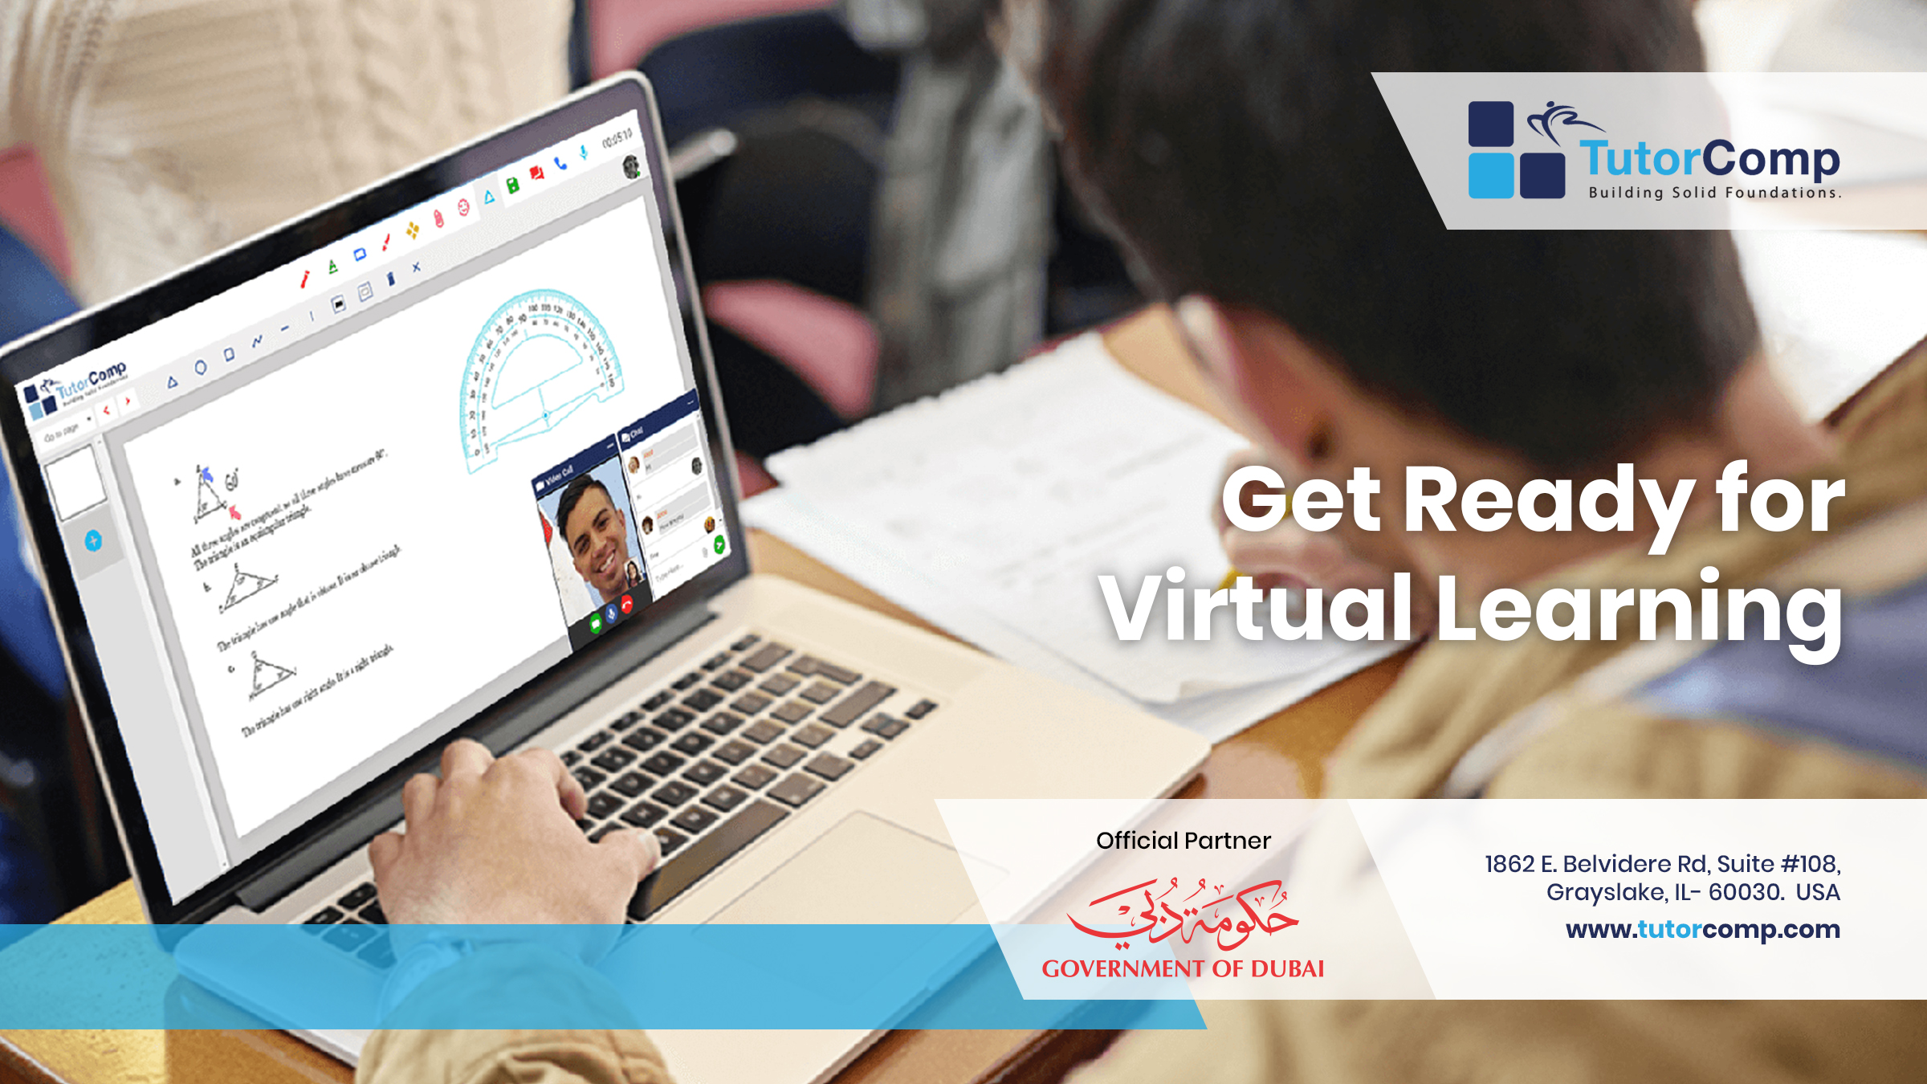


Personalised virtual learning

Slide 2

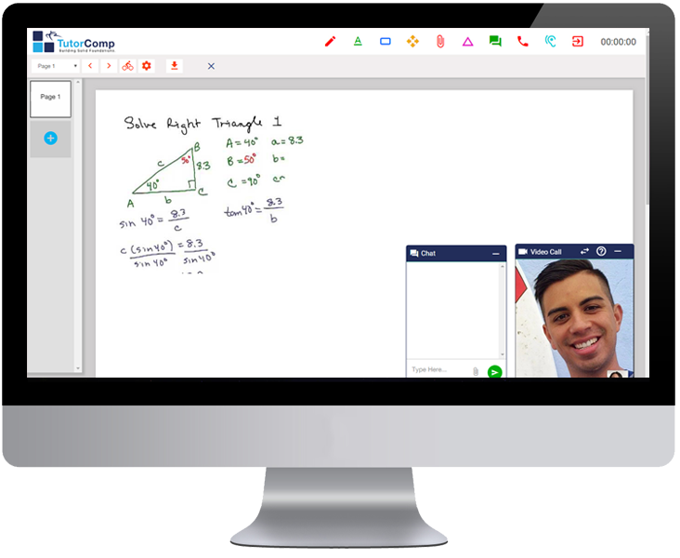
TutorComp is the online tutoring company providing personalized 1-on-1 and group tutoring sessions to K-12 students and adult learners all across the world.
Our virtual platform gives remarkable access to students and educators to connect and explore the joy of learning in a smart technology enabled environment.
What is our smart environment?
Our smart environment features collaborative teaching tools meant to engage and capture student’s rapt attention, by giving priority to teaching in student’s own pace and skill.
Our whiteboard allows clear audio-video calls for 1-on-1 and group sessions, where students and educators can connect from really any part of the world.
Our platform not only guides students to become tech-competent in the most effective way, but also imparts them with immense live support from a qualified educator throughout their learning process.

Slide 3


what
we offer
why our sessions are
Expert coaching classes for
popular
SAT
IELTS
Highly experienced tutors from
different parts of the world
TOEFL
PSAT
IB
ACT
Subject Materials for Every Class
Past Paper Discussions
NEET
JEE
Regular Practice Tests
CAT
NAPLAN
Instant Students Performance Reports
SELECT ENTRY EXAMS

Slide 4
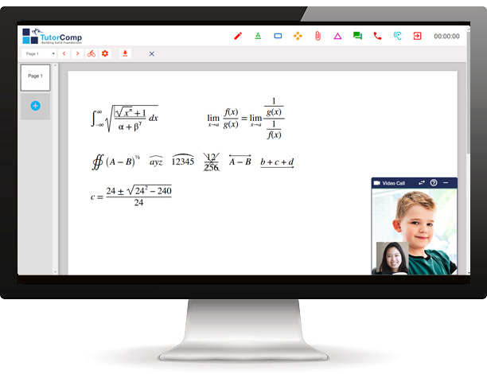
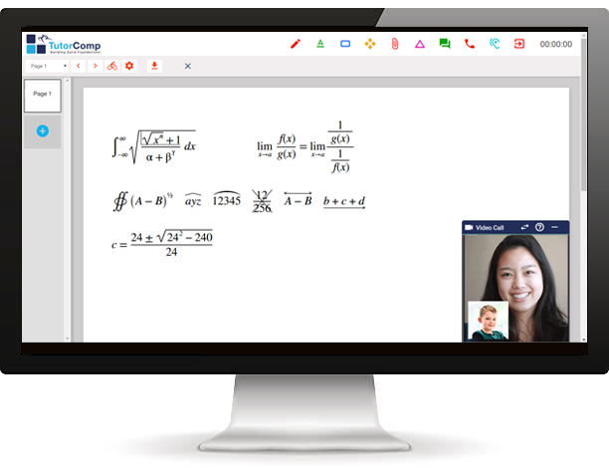

how our program works
Model 1 : One-One Tutoring
Tutor connects to the class online from their location
Student connects to the class from their home

Slide 5
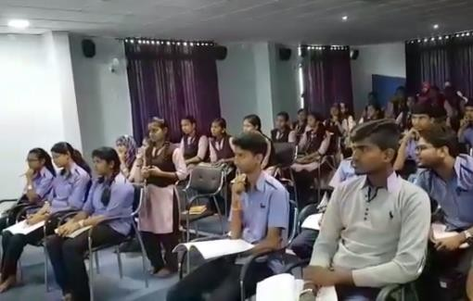

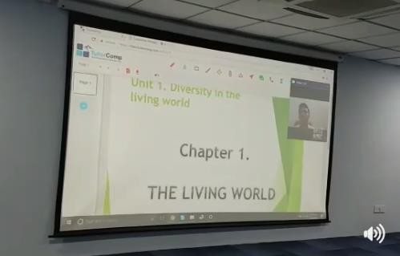


Model 2 : Group Class
1 2 3
Tutor takes the class online from their location
Class is projected to the classroom screen using TutorComp Application
Students actively interact with the tutor in class
Our classes do not intrude or disturb the classes and rhythm of school, rather supplements it.

Slide 6
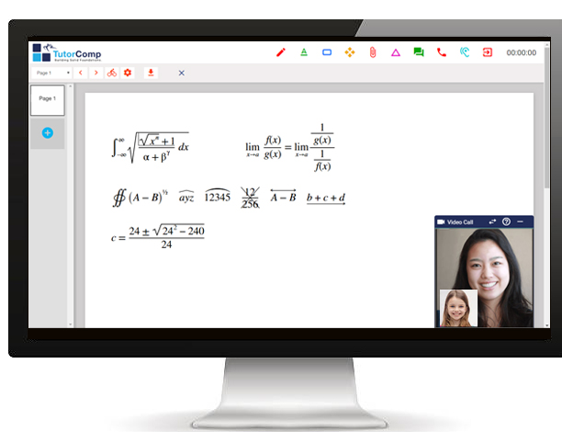
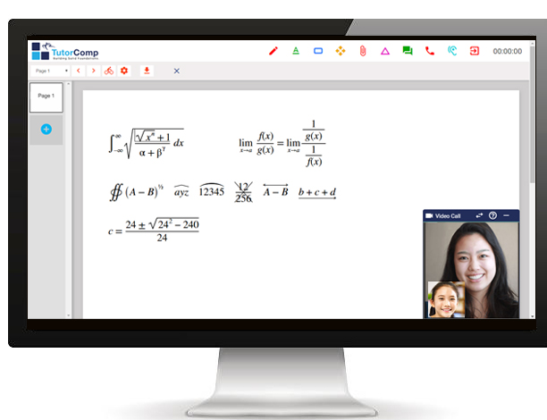
Model 3 : Group Class
Tutor connects to the class online from their location
Student 2
Student…’n’
Student 1
Students connect to the class from their own respective locations

Slide 7

our program details
Exclusive Course Materials
Classroom tutoring complemented by course materials that focuses on both concepts and techniques of problem solving.
Covers All Topics
Integrated and comprehensive coverage of all related subjects with separate course materials for all major test preparation courses.
we bring
Regular Tests
Regular practice tests in all lessons, along with instant student performance report.
expert tutors from Europe, US, INDIA to your school campus!
Homework & Assignments
Regular homework and assignments to brush up and polish student’s grasp on the subjects.
Collaborating Learning using Technology
Online group class with an expert tutor improves student learning, supports peer discussion, and motivates them to achieve better results.

Slide 8
why schools choose
us
Our program supplements the teaching in schools
Schools provide niche coaching for entrance exams and thus improve their annual results and ranking
Our tutors do not disturb the school rhythm, since class takes place online
Schools get the opportunity to get service of expert &
experienced tutors from different cities in India
TutorComp program is laid out in a way to help students reinforce subject concepts for better results
Schools get better results in not just entrance exams but
in regular board exams

Slide 9
TutorComp offers academic support in all
major school curriculums like:
Subject help is in:
Australian Curriculum
CBSE/ICSE
Accountancy
Biology
GCSE
IB – PYP/MYP/DP
Business Studies
Chemistry
IGCSE (AS/A levels)
US Curriculum
Computer Science
Mathematics
Physics
Social Studies

Slide 10
Language Training in subjects:
English
Arabic
French
German
Hindi
Sanskrit
Spanish
Italian

Slide 11


TutorComp Inc.
Registered Office
1862 E. Belvidere Rd, Suite #108,
Grayslake, IL- 60030. USA
Official Partner
Office
Space No. 7, 2nd Floor,
Park Office, Athulya Building, Infopark, Kakkanad, Kerala INDIA – 682 042
mkt@tutorcomp.com
www.tutorcomp.com

